Slide 1
Hospital management system
Relaxed style presentation
18.07.24
Ding Yeming

Slide 2
Project introduction
The main body of hospital management information is the medical information of patients. With the in-depth application of information technology in hospitals, we need to study and deal with the relationship between medical orders and patients' accounting, medicine, examination, treatment and so on.
Combined with course learning, the task of this project is to design a hospital management system, which is developed based on Django framework, combined with html front-end framework, uses Python language, and uses MySql as the background database, so as to satisfy users' online viewing of hospital information data and other functions.
The core function modules of this system include: doctor management, patient management, ward management, department management, drug management, authority management and so on.

Slide 3
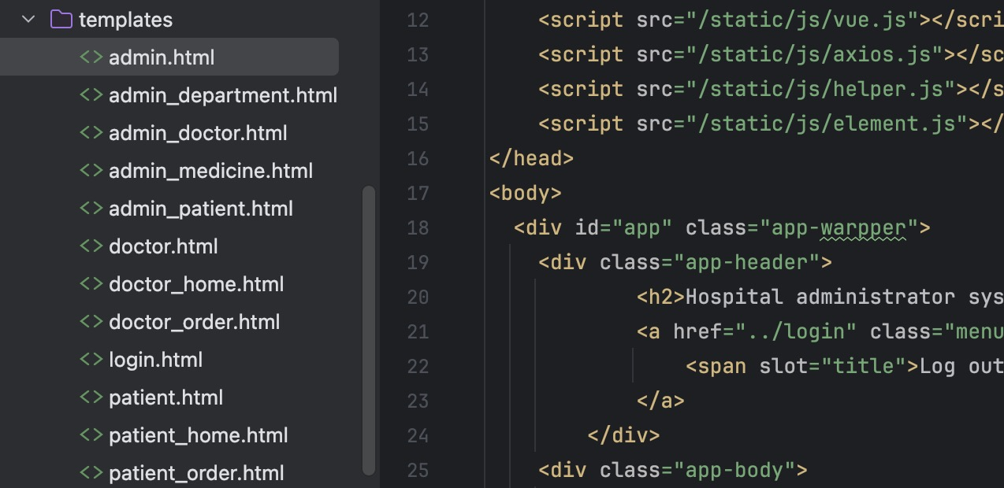
HTML

Slide 4
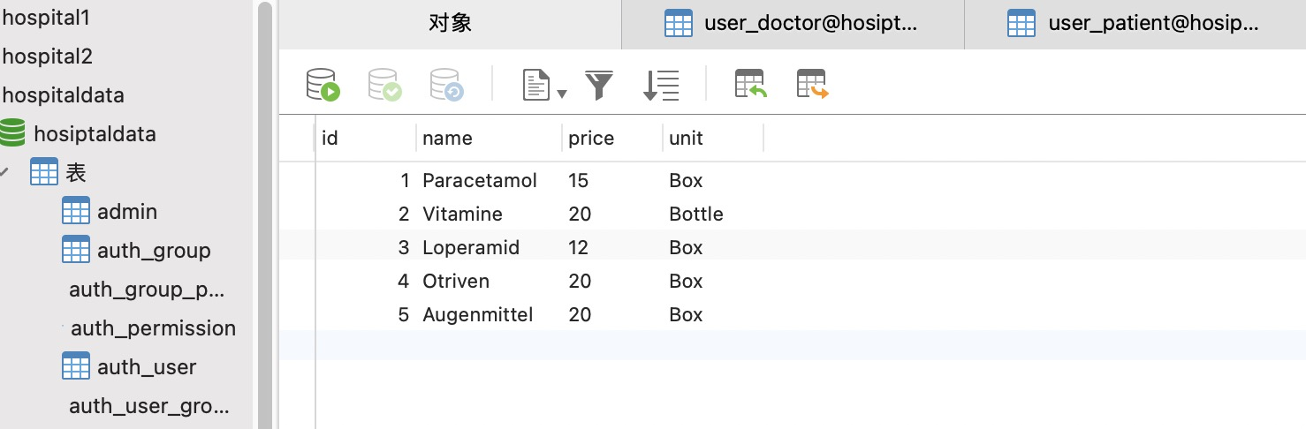
SQL

Slide 5
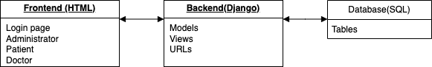
Structure
Front-end (HTML) : Presents the user interface.
Back end (Django) : The back end includes models, views, and URL routing.
Database (SQL) : Store data, doctor information, patient information.

Slide 6
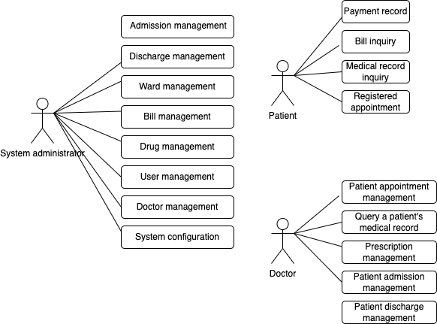
System use case

Slide 7
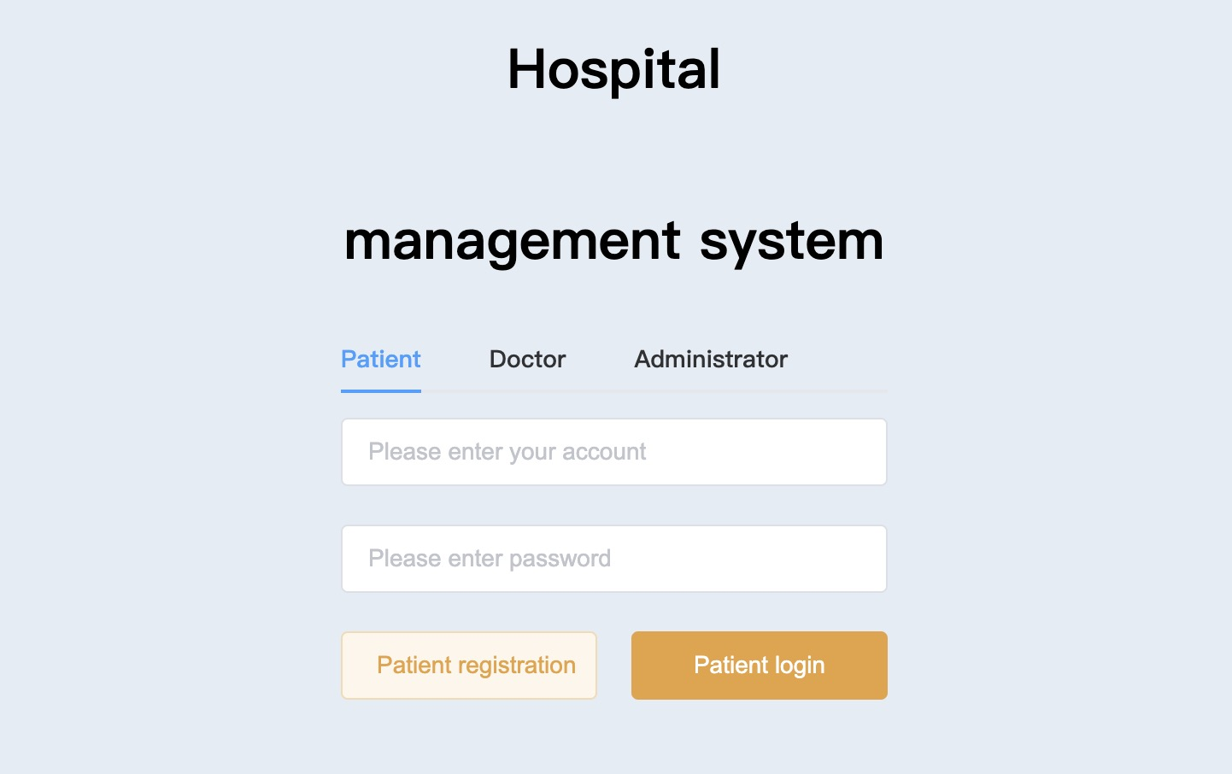

Slide 8
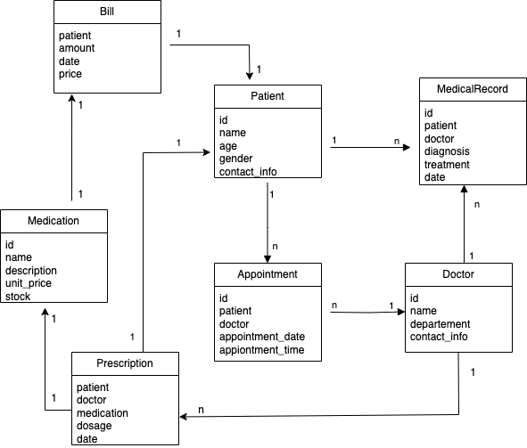
class diagram

Slide 9
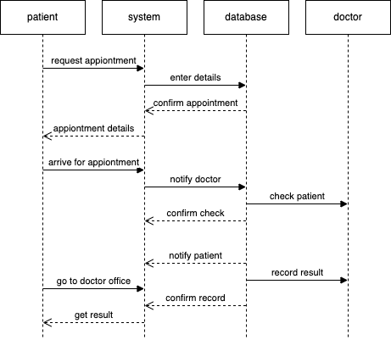
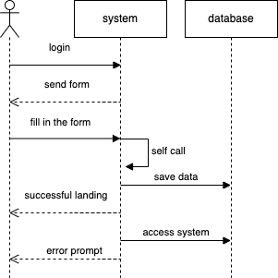
Sequence Diagram

Slide 10
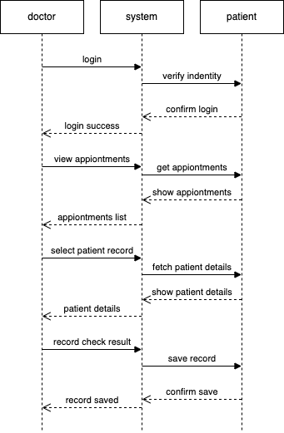
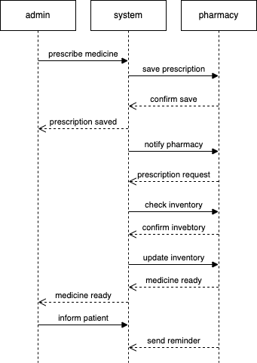
Sequence Diagram

Slide 11
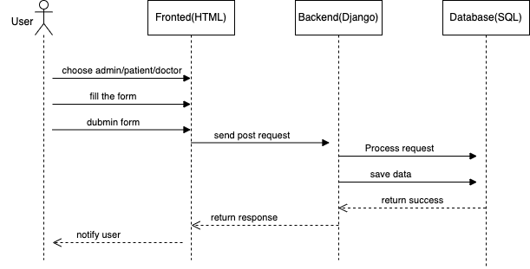
CRUD Sequence Diagram

Slide 12
Function: Doctor Information Management: Administrators can add, edit, and delete doctors' personal information, including name, gender, contact information, and more. Patient Information Management: Administrators can add, edit, and remove patient personal information, including name, age, contact information, etc. Medical records management: can record and view the patient's medical records, including medical time, symptom description, diagnosis results, etc. Department information management: Administrators can add, edit, and delete department information, including department names and department directors

Slide 13
Function: Drug Information Management: Administrators can add, edit, and delete drug information, including drug name, drug specifications, etc. Inventory management: Support drug inventory management, including drug storage, storage and inventory inquiries.

